Slide 1
Reducing Greenhouse Gas Emissions in NJ
Jim Thomas – Thomas Geothermal Engineering LLC
Robert Jensen – Agreenability
October 9, 2018 NJDEP

Slide 2
Overview
Putting some realism into achieving our stated goals of 40% reduction by 2030 and 80% below 2006 levels by 2050
Barriers to achieving our goals
The available technologies
What others are doing
What NJ might want to do

Slide 3
The Current Outlook
To date there has not been a clear vision as to how definitive actions and investments will translate to the overarching desired goals
NJ is relying – at least in part – on an updated Energy Master Plan to help accomplish this
Clean Energy Programs in NJ to date have nibbled around the edges with a mix of small incentives in an attempt to change behaviors of customers, the trades, and utilities
Maybe worse, they are still providing incentives for fossil fuel devices that will be in service at least the next 15 to 20 years and beyond the 2030 goal. Is that a good idea?
Natural gas lines are still being extended into new territory but we know that must be curtailed. This will create yet another new issue of “stranded assets” down the road and wasted investment

Slide 4
What are we up against?
As of 2017 NJ had 3,214,360 households
We can estimate that non-renewables currently heat about 3M of those homes for the sake of discussion
If we assume half of those must be converted by 2030 then we’d need on average about 136,000 conversions per year
As of 2016 there were 2,823,067 cars, 2,882,053 trucks, 151,101 motor cycles and 22,769 buses registered in NJ
This would require about 257,000 new electric cars per year
It’s not clear there is a renewable solution in the truck sector today
There is no solution for the motorcycle segment, but it is small
We’d need about 2,000 electric or hydrogen fuel buses per year
Many commercial, industrial, and manufacturing processes will need fossil fuel into the foreseeable future

Slide 5
What are we up against?
The Federal government is poised to rollback fuel economy standards in the automotive sector
This may cast into doubt what electric vehicle selection will be
It sends a message to consumers that conversion is not necessary
Consumer preferences have been tilted towards SUV and pickups that will be harder to electrify
We will likely need more power storage to balance the load on the grid
NJ has one commercial scale pumped hydro storage in Yards Creek – can release 420 MW of energy over a 5.7 hour period at peak operation; facility was built in the early 1960’s
Study by Oakridge Labs in 2011 did not identify any other new candidates in NJ
Other forms of commercial scale power storage are starting to come online but will be expensive
Battery packs in the home are becoming available but are not yet a commercial scale product. Current batteries have a finite operating life
But NJ has made a large commitment to offshore wind power, reversing 8 years of stagnation
The Federal government still has large tax credits in place for solar, wind and geothermal but they will phase out

Slide 6
What are we up against?
Rooftop solar is being promoted in NJ and other states as a solution
Many homes do not have the proper southerly facing roofs, do not have the required tilt, or direct sunlight (no shade) to get the most out of this investment per dollar spent
Many municipalities require variances for ground installations that could overcome this; but many people just don’t have the room needed
Community solar can overcome these difficulties and can produce greater output per dollar and is finally getting its due
The industry is not being helped by the 25% tariffs recently placed on Chinese solar panels
Geothermal HVAC installations fell to about ½% market penetration after losing the Federal tax credits in 2017
Recovering from 2017 has proved difficult for this trade
NJ Clean Energy zeroed out incentives for geothermal; they had previously been $500 per unit – hardly enough to change customers choices

Slide 7
The Most Important Term to Learn
Coefficient of Performance or COP – how much energy is output from an HVAC system versus how much is input
Heat Pump systems move heat energy to or from the ground or air – and then compress it to a more useable state
Example: Typical 2500 SF home needs “5 tons” or 60,000 Btuh of heating
COP=1 17.57 Kwhr Electric resistance heat
COP=1.5 11.71 Kwhr cold climate Air Source Heat Pump @ 0⁰ F (ccASHP)
COP=2 8.79 Kwhr ccASHP@ 5⁰ F
COP=3 5.86 Kwhr
COP=3.5 5.02 Kwhr typical closed loop Ground Source Heat Pump (GSHP)
COP=4 4.39 Kwhr high performance GSHP
COP=5 3.51 Kwhr open loop GSHP
COP=6 2.92 Kwhr GSHP with thermal storage, multi-source
A very compelling case to keep COP high to very high during winter peak periods to minimize impact on the grid

Slide 8
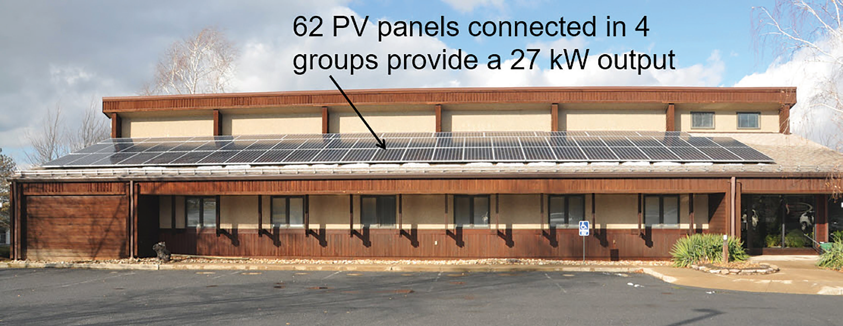
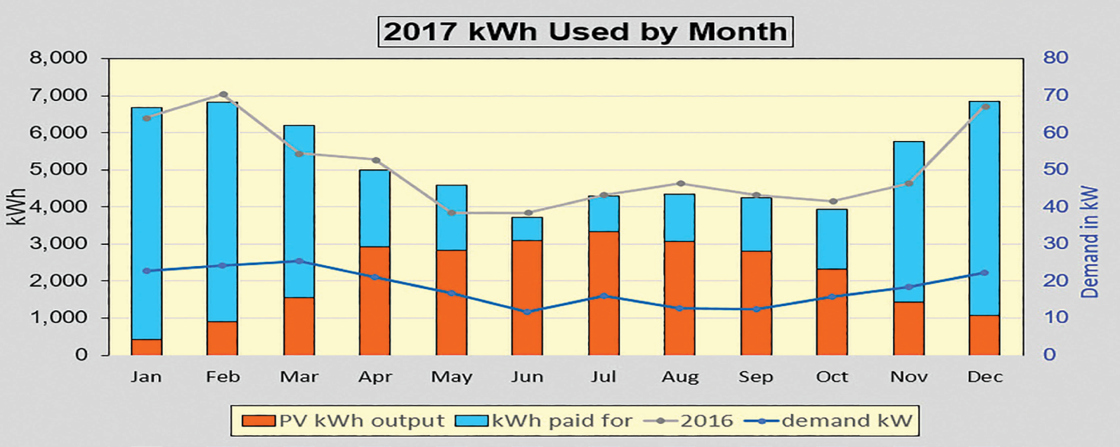
The Problem with Solar
Source: IGSPHA Geo Outlook, 2018 Vol 15, No 3 Building located in State College, PA

Slide 9
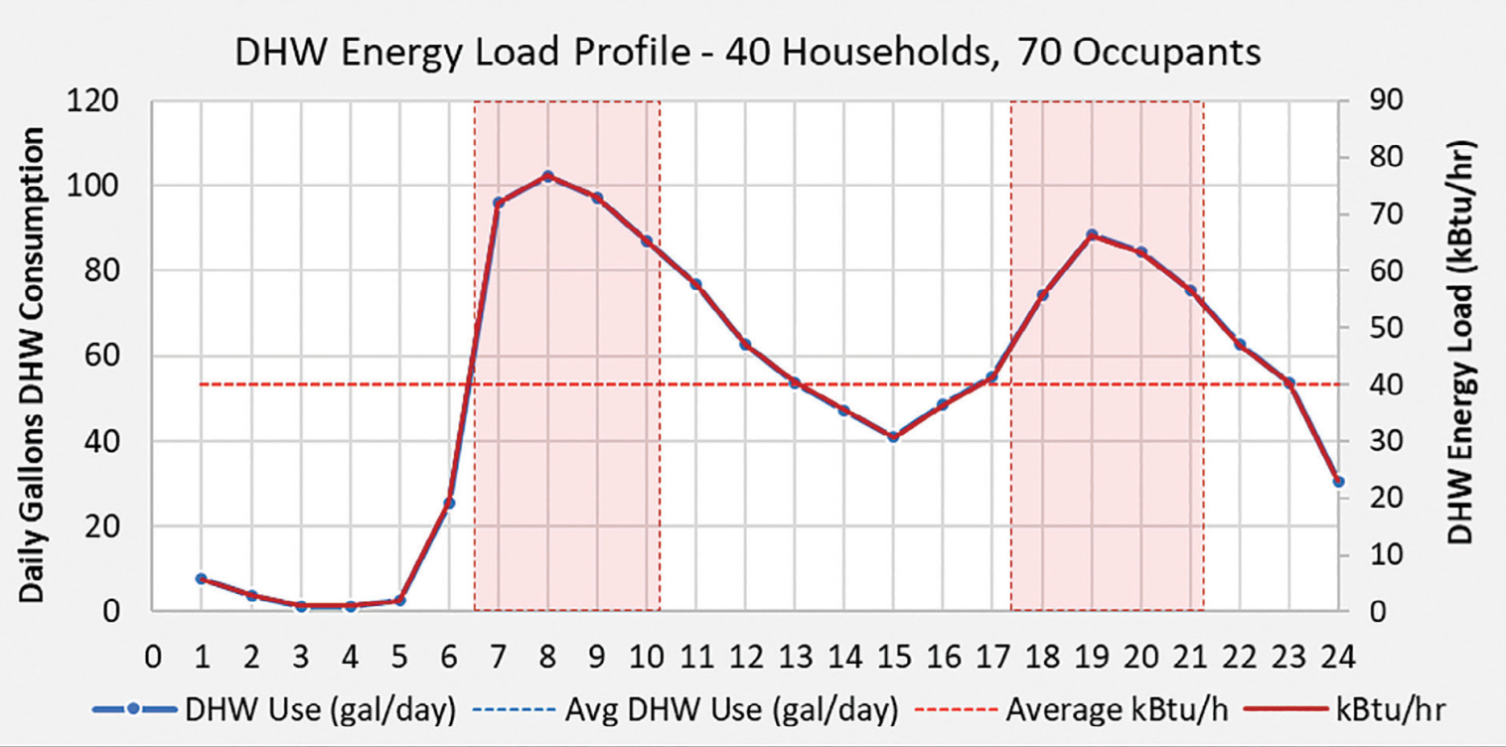
The Problem with Domestic Hot Water
If we want to convert a building or home’s fossil fuel space heating, we’ll need a companion high COP Domestic Hot Water (DHW) capability too.
Electric water heaters have a COP=1 and Hybrid Heat Pump water heaters can deliver about twice that on a yearly average
Source: IGSPHA GeoOutlook, 2018 Vol 15, No 1

Slide 10
The Problem with DHW
From the previous figure DHW has a morning peak that would coincide with lowest winter temperatures and occupants upping their thermostats to recover from nightly setbacks
DHW also has an evening peak that again coincides with setback recovery after work, and with cooking and perhaps clothes washing and drying
We need a higher COP DHW solution to shave this peak
NYSERDA is providing a $3500 rebate for a dedicated water-to-water GSHP solution from WaterFurnace @ COP=3.5 – it’s still expensive
Obviously this solution only works for those who have a properly sized geo-exchange
NJ should rebate high COP DHW solutions like NYS and encourage manufacturers to provide less expensive standalone geo-based DHW devices in the $1,200 range

Slide 11
Power Company Dilemmas
If correct choices are not made the added demand will likely require large investments in both the Transmission and Distribution side as well as on the Power Generating side
Bringing on new renewable power generating will be a large and expensive task – tempering peak demand will be essential while wind power will be unpredictable
Keeping nuclear power – about 40% of our clean generating capability - economically viable will come at a cost
The traditional summer daytime peak load will shift to winter pre-dawn hours if heat pumps are used for space heating and Domestic Hot Water (DHW)
Solar will need to be a major part of the renewable energy mix, however it’s output is lowest in winter, varies because of cloud cover, and is virtually zero at what will be the new winter peak

Slide 12
What strategies makes sense today?
Common sense would say make choices that will work within the existing grid; for homes with central A/C this would be retrofitting a heat pump that has about the same demand
We’ll need to keep electric vehicle charging out of phase with peak space and DHW heating – may mean charging vehicles during the day
Electric vehicles can provide some energy storage for on-peak use through Net Metering or Smart Meters
For homes and buildings where the fossil fuel systems were recently replaced it comes down to using less through insulation, sealing, and better windows and doors
Smart thermostats and setbacks may provide some gains on fossil fuel systems with excess capacity but setbacks greater than about 4⁰ F on heat pumps just kicks on electric heat

Slide 13
What strategies makes sense today?
Until we can determine new ways to reliably and cost effectively generate and store electric power, emphasis in the short term should focus on:
Constructing better buildings and homes starting today
Shift from fossil fuels on new buildings, major renovations and end-of-life equipment replacements
If choosing heat pumps size equipment to meet the winter design day without auxiliary heat
Electric resistance elements should become Emergency Heat
Implies we may have to limit the deployment of ccASHPS
Look to manufacturers to give us even better equipment
Ultimately it comes down to making the most cost effective investments to benefit society at large and reduce resistance to the required changes

Slide 14
So why not just deploy all GSHPs?
We all wish it were that simple but there are market barriers
High initial cost is the most often cited; the standard design geo-exchange can be 40% of the project cost
Low current market penetration (now about ½%) presents a growth issue – we’ll probably need to achieve 50% or more by 2050
Creative funding like Property Assessed Clean Energy (PACE) is becoming more available but really just side steps the high cost
Likewise GEOSmart financing available from EGIA.org; some states have started Green Banks
The current HVAC installer base is heavily invested in conventional fossil fuel and conventional A/C technology
Customers will be offered replacement fossil fuel/conventional A/C systems because that’s what their current company sells
The GHP currently requires vertical or horizontal designs – either requires substantial disturbance of existing properties and even the more compact vertical design requires 3 or 4 boreholes that can’t work in dense urban environments
Lack of drillers and equipment to go mass market quickly

Slide 15
Our History in NJ
The NJ Clean Energy Program (NJCEP) has unwittingly moved away from high COP GSHPs in favor of ccASHPs – impact on the grid at winter peak apparently not considered
Mass conversions from fossil fuel heat to ccASHPs will have a tremendous impact on the ability to deliver reliable and resilient electric power during winter peaks
Nothing has been done in the past 50+ years to build more large scale power storage since Yards Creek
No consideration has been given to thermal or seasonal storage
As witnessed from the State College project solar PV – even if coupled with massive amounts of short term battery storage – will not likely to be enough to shave the peaks

Slide 16
Learning from Others
Our neighbor in New York has a multi-year head start and has established a myriad of programs:
Retrofitting old buildings up to near Net-Zero
Eliminating many fossil fuels in NYC
RevConnect program to connect ideas to power companies
Customer outreach programs
Renewables training for the trades
Standards for installing GSHP systems; projects that meet these standards get a Quality Assurance from NYSERDA
Significant direct rebates (not tax credits) for GSHP installations:
Most of NYS receives $1,500/ton up to 10 tons
PSEG-LI customers receive $2,000/ton
National Grid customers (Upstate and Western NY) receive another $1,100 per installation

Slide 17
What Else Can We Do?
Drive down the cost of GSHP systems by using an Air Source/Ground Source Hybrid design
We’ve performed simulations using an actual Grand Forks, ND commercial building to show it can work
Research papers document installations in Europe
A German company – SmartHeat – now manufactures an all-in-one hybrid unit
In conjunction with high performance geothermal pipe, the geo-exchange size can be reduced up to 75% - this translates into about a 25% project cost reduction
The smaller geo-exchange means ¼ the amount of drilling and would extend our current fleet of rigs up to 3 times
In many cases we’d need only one bore – opens up potential sites
We need ccASHP manufacturers to add a geo connection, or GSHP manufacturers to add a air source connection to turn this into a mass market solution

Slide 18
What Else?
Adopt new building standards to drive down demand
Phase in high COP space and DHW heating as standard – waivers required to install new fossil fuel units
Streamline the well permitting for geothermal
Each bore is considered a separate well even though no water is ever pumped and the bore is quickly outfitted with pipe and grouted over
Multiple and almost identical Well Permits and Records are filed even though the bores are usually 15’ to 20 ‘ apart
Same fee charged for each bore; most “5 ton homes” use 4 bores
Mandate that geothermal wells not only be grouted, but the grout must have a thermal conductivity (TC) of at least 1.0 unless a TC test establishes that it should be higher – standard bentonite grout with a TC = 0.4 significantly reduces the performance of the well

Slide 19
What Else?
Streamline the installation permitting and inspection
A GSHP installation now covers 4 subcodes with individual applications and fees: Mechanical, Building, Electrical and Plumbing
In many municipalities this means 4 different inspectors and 4 appointments
Geothermal units purchased from in-state distributors subject to sales tax even though the installation in total is not taxed as a “Capital Improvement” (NJ Form ST-8)
State taxes and fees cost an average $1,300 per residential GSHP installation and cannot be deducted from Federal taxes
Re-introduce electric heat electric rates – even high COP heating must compete against very low natural gas prices
Time of day pricing could encourage customers to move electric vehicle charging and other ancillary use to off peak times and save them money by selling it back at peak

Slide 20
PSEG Clean Energy Future Plan
$2.8B in Energy-efficiency programs – efficient appliances, smart thermostats, energy audits, low cost energy efficiency kits, etc
$364M for 37,000 electric vehicle chargers in homes, 2,200 mixed use buildings and 150 fast chargers on the road; includes 50 to 100 electric school buses for low-income areas
$180M for 35Mw of energy storage
$800M on “Energy Cloud” based around Smart Meters
No mention of heat pumps in press releases
In total a $4.1B plan. Is this the best way to spend this money? Will this achieve the 2030 GHG goals?? It’s cast as saving consumers money, but how much does it reduce GHGs???

Slide 21
Where to from here?
Food for thought - Group Discussion
Should we have a utility level service to deliver heat energy via pipes in our streets?
UN Intergovernmental Panel on Climate Change – planet will reach crucial threshold of 1.5⁰ C as early as 2030. Aggressive action needed immediately
Establishing a research track for emerging technologies
Takeaways and Action Items

